Slide 1

Prototype 1
By Charles Doucet

Slide 2
Artist's Statement
Platformer environment to be ugly and without interest
After a while, he falls into a glitch and become stuck into the computer
Inside the machine will be more elegant, minimalist and dark
What happens in a device and how it is seen by a segment of the code
Character has emotion and knows he’s been controlled

Slide 3
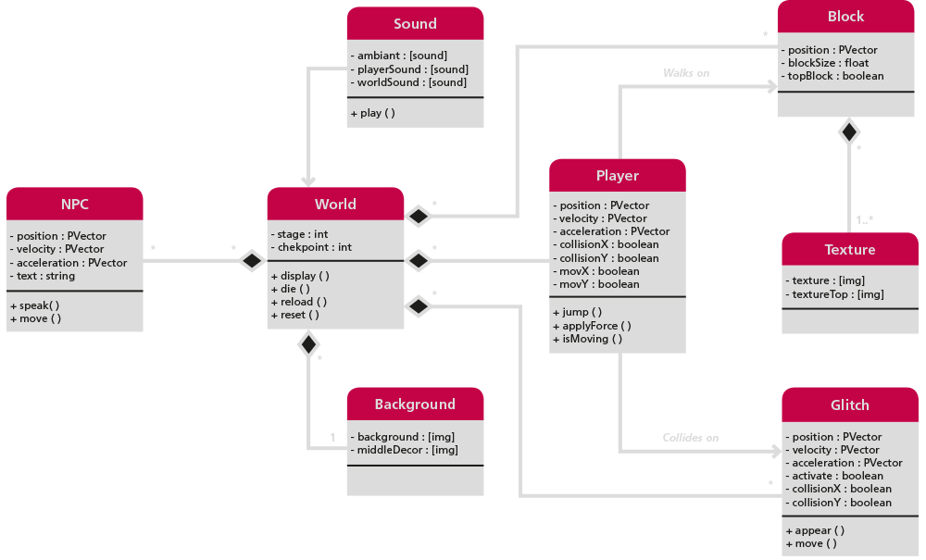
Class Diagram

Slide 4
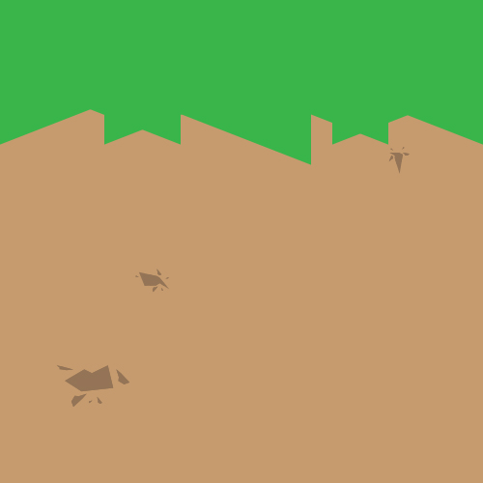

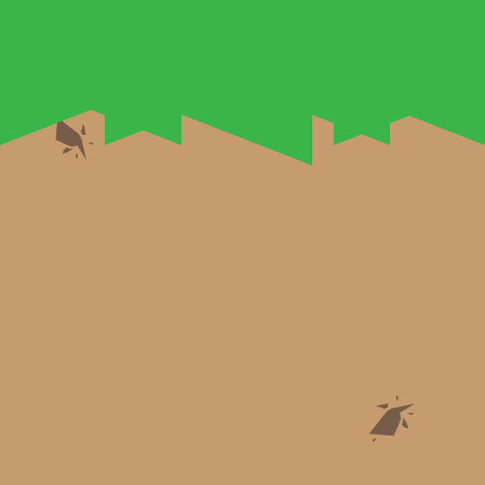
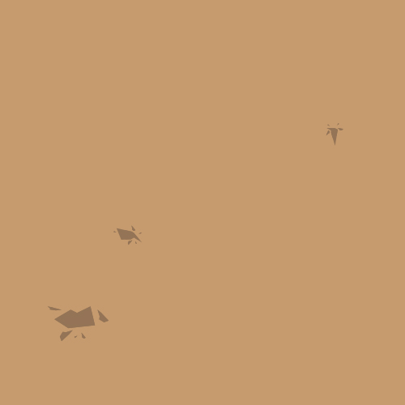


World Creation
texture_1-1_top.jpg
texture_1-2_top.jpg
texture_1-3_top.jpg
texture_1-1.jpg
texture_1-2.jpg
texture_1-3.jpg

Slide 5
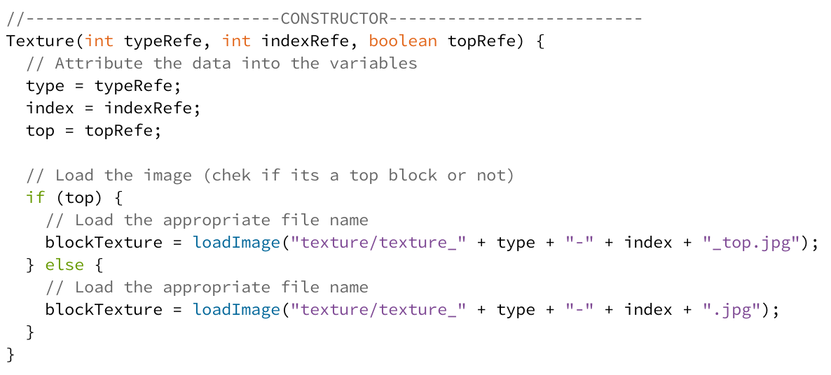
Class Texture

Slide 6
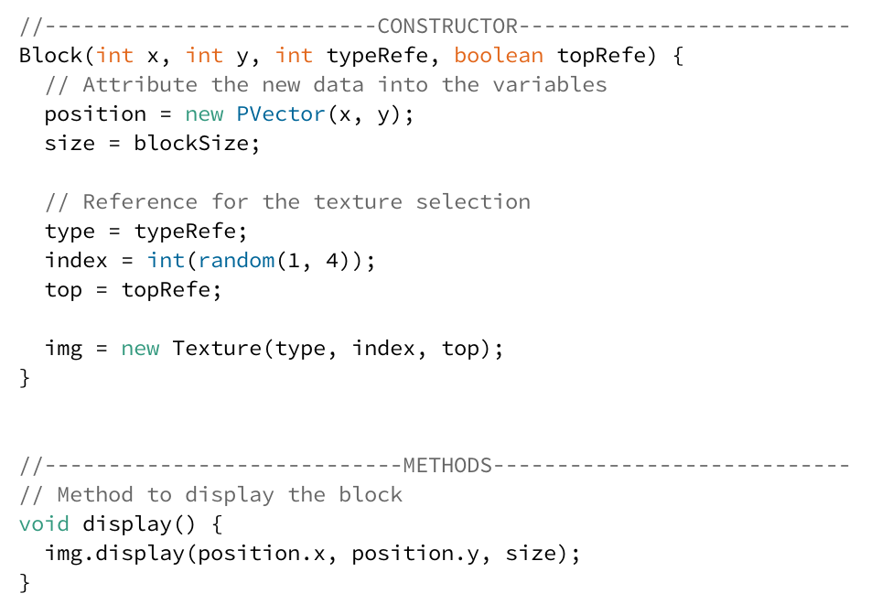
Class Block

Slide 7
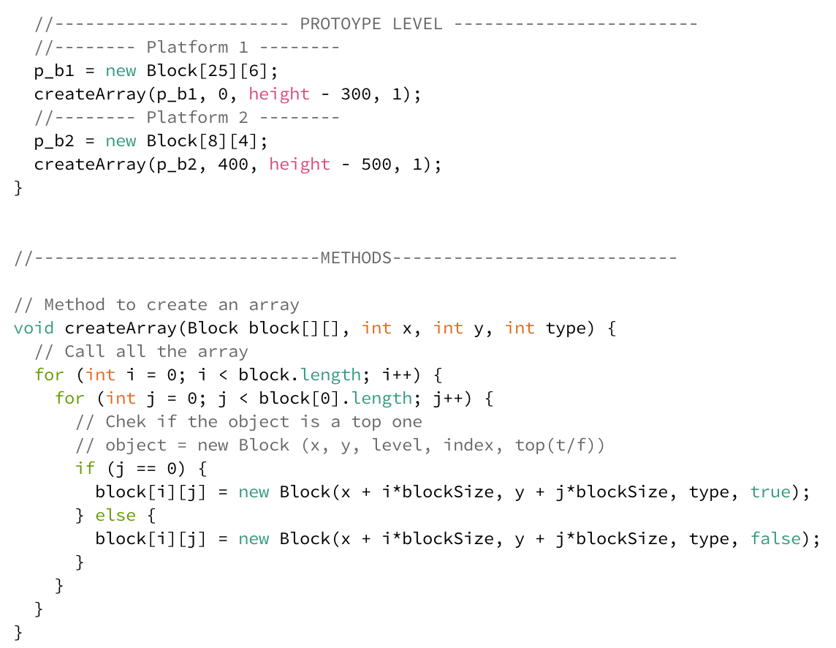
Class System (setup)

Slide 8
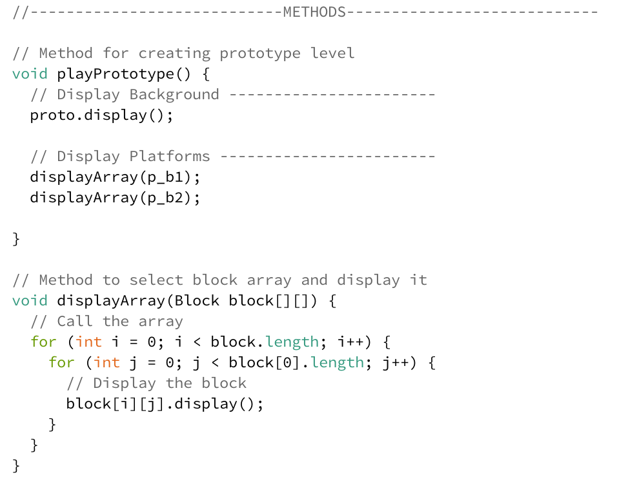
Class Level (world)

Slide 9
Class Level (world)

Slide 10
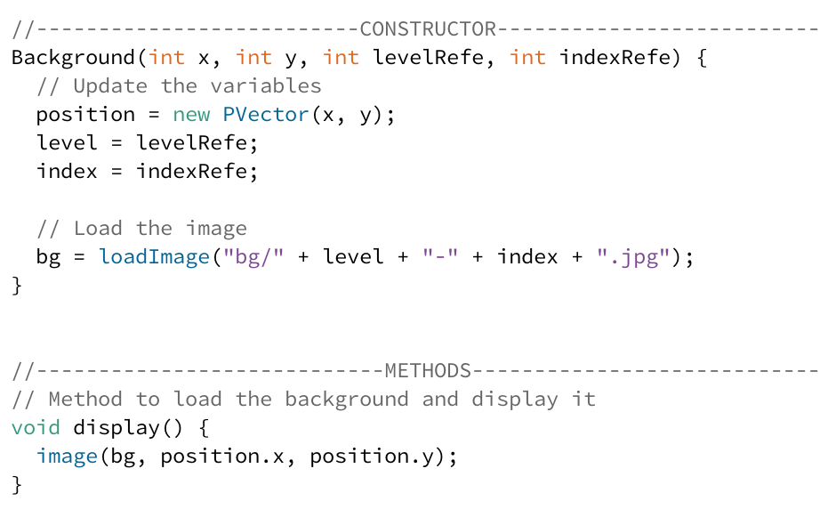
Class Background

Slide 11
Thank you

